Slide 1
Level Design
Introduction to Game Design and Development
ITCS 4230/5230
Dr. Dewan Tanvir Ahmed
Department of Computer Science
University of North Carolina at Charlotte

Slide 2
Objectives
Understand how level design can
enhance or undermine a game’s story and gameplay
List the possible level layouts and understand
when to use each and how to combine them
Understand the importance of
atmosphere, pacing, and progression

Slide 3
Objectives (cont.)
Describe the key aspects of the level design process
Recognize some of the pitfalls of level design
inappropriate scope and
conceptual non sequiturs

Slide 4
What Is Level Design?
Level design: constructing the experience for the player using components from the game designer
Level designers create:
Space in which the game takes place
Initial conditions of the level
Set of challenges within the level
Termination conditions of the level
Interplay between gameplay and story
Aesthetics and mood of the level
Creates gameplay through environment and systems
Handles the technical implementation of a space

Slide 5
Gameplay - Meaningful Play
We don't want arbitrary play.
Games must have well connected game systems
The Level designer connects elements such that
The player is engaged
Compelled to make decisions
Choices feel interesting to him
“A group of interacting, interrelated, or interdependent elements forming a complex whole.” (Rules of Play)
Notes:
What this really means for us:
No arbitrary play. Having well-connected game systems is a good first step. The LD connects elements so that the player is engaged and compelled to make decisions, which feel interesting to him.
How Do We Create meaningful play in a level?
By using the two elements from the LD definition:
The environment and
game systems.

Slide 6
Gameplay - Meaningful Play
How Do We Create meaningful play in a level?
By using the two elements from the LD definition:
Game Systems
The Environment
Notes:
How Do We Create meaningful play in a level?
By using the two elements from the LD definition:
The environment and
game systems.

Slide 7
Game Systems (1/2)
A collection of properties and behaviors
Examples of game systems:
Guns –
the properties are the look, feel and ammo capacity, while the behavior is the shooting
Item Pickups
Enemies
the properties are the visual look, while the behavior is the AI behavior.
Movement
Notes:
We could look at the definition of a system here, but really, this one is easier: “a collection of properties and behaviors”.
In a gun, the properties are the look, feel and ammo capacity, while the behavior is the shooting.
In enemy AI, the properties are the visual look, while the behavior is the AI behavior.

Slide 8
Game Systems (2/2)
Game systems don’t work well in isolation:
A rocket launcher shoots rockets doesn’t serve a purpose on its own
Adding another game system – enemies - gives us a target, we create play
Well-connected systems (fun) => compelling gameplay
Notes:
Game systems don’t work well in isolation: A rocket launcher shoots rockets, but it doesn’t serve much of a purpose on its own.
Adding another game system - enemies - gives us a target. We create play.
Well-connected game systems create “fun” (which is a slippery term, as I already mentioned). They have the potential of creating compelling gameplay
The systems can’t do this in a void of nothingness, though!

Slide 9
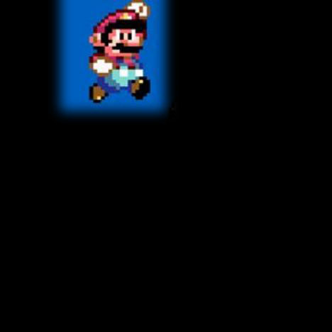
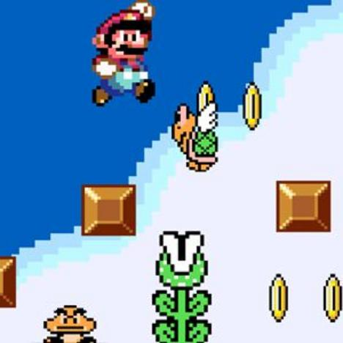
Game Environment (1/2)
In a void space - none of the game systems would work
The Level designer combines game systems against the background of the level
the level facilitates gameplay
Notes:
In a void, none of the game systems would work.
Mario in a void = not fun. He needs the level to put jumping, shooting etc. to use.

Slide 10

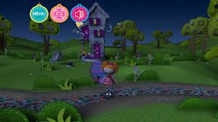
Game Environment (2/2)
Provide Constrains and guides player movement through physical properties and ecology
Uses player reference to communicate simulation boundaries and affordance
Reinforces and shapes player identity
Provides narrative context
Notes:
The game level is the *enabler*, so let’s describe a game level.
Constrains and guides player movement through physical properties and ecology
Uses player reference to communicate simulation boundaries and affordance
Reinforces and shapes player identity
Provides narrative context
Right now we’re interested in the first two functions.

Slide 11
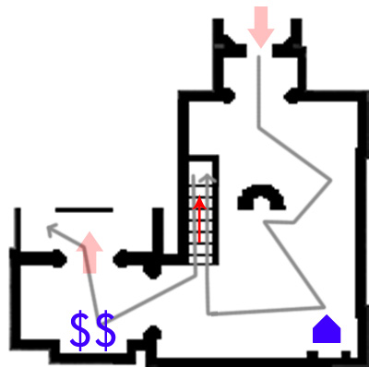
Physical Properties and Ecology
Constrains and guides player movement through physical properties and ecology.
Gameplay = Item placement
+ connected game systems
+ level layout
Notes:
This is the map from our Bioshock example.
The physical properties are represented by the walls, staircase etc, while the ecology is made up of enemy and item placement, which guides our way through the space.
We can also see that a game environment, through its physical properties, represents access (otherwise, it would be a void!), and that these restrictions on access create decisions and meaningful play.
Compare that to games in general, which are inherently inefficient: Want to put a little white ball in a tin cup on the middle of a field? The fastest way is to pick it up, drive over, and drop it in the cup. But that doesn’t describe the game of Golf! Restrictions in the form of rules create meaningful play.
In an environment, the physical properties do likewise.
The item distribution (the “ecology”) term, leads to exploration – otherwise we would simply have entered at red arrow #1 and left at arrow #2.
That’s the magic of good level design – compelling the player to do things he wants to do, but isn’t forced to do.
---
This is a very low-level look at the environment, and this kind of analysis leaves out a lot of detail that give Bioshock its identity.
And that's because we fail to take into account how the visuals affect our play.
---

Slide 12
Affordance and Boundaries
Affordance:
The properties of an object which suggest how it can be used and what it does.
Simulation Boundaries:
The line beyond which the imitative representation of a system is discontinued.

Slide 13
Level Structure
Level designers create structure which creates goals, which lead to motivation
creates micro and macro goals
Creates an underpinning for experiences
A game is comprised of experiences
Creates choke points
Notes:
The level designer creates structure, which creates goals, which lead to motivation.
We need to understand structure before we can bring our level from the design doc to the engine.

Slide 14
Level Structure
Game start
Game end
missions
Game end
Game start
Mission structure
Mission end
Mission start
Notes:
Working our way down, we can break that game into missions.
Each mission also brings players on the same page.

Slide 15
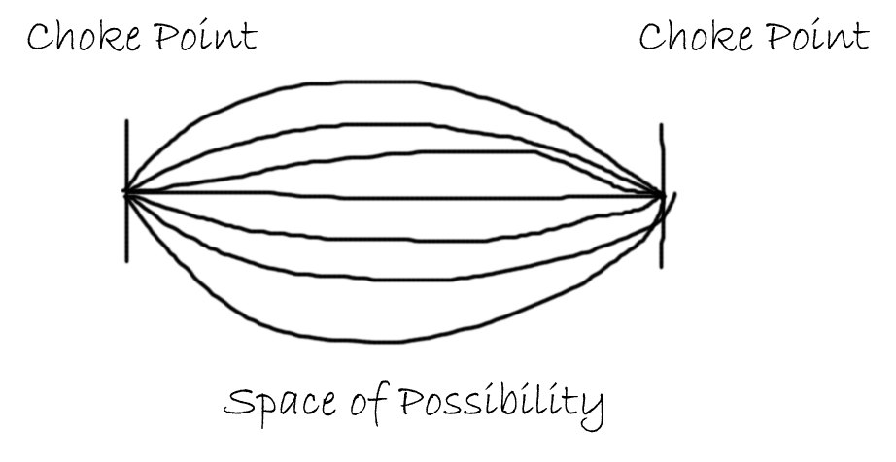
Experiences
Between each choke point lies an experience
The wider the fan, the more emergent the game has the potential of being.
Movies are linear.
Final Fantasy would be a couple of lines between each structural choke point. FF is very linear, and all players play the games roughly the same.
Far Cry 2, which is shown here, would be a very wide fan.
Notes:
That’s “experiences”. Movies are made up of scene. Games are made of experiences.
We could draw a charts for a movie, which would only a single line between two structural (choke) points. Movies are linear.
Final Fantasy would be a couple of lines between each structural choke point. FF is very linear, and all players play the games roughly the same.
Far Cry 2, which is shown here, would be a very wide fan.
The wider the fan, the more emergent the game has the potential of being.
We could also color-code this possibility fan, showing the possible number of permutations for *environment* and for *gameplay*.
Some games, like Dead Space, are wide on the gameplay fan, but small on the environment fan. That shows us that the enemy gameplay in Dead Space is very different for different players (complementary enemy types and mechanics like stasis open up a world of possibilities). But all players use the environment roughly the same way.
Important: not all of these paths between the structural points are weighed the same! Some paths are more optimal than others. That dives into intentionality, and is outside the scope of this session.
But we can say that structure creates a *rhythm* for the level. It creates breadcrumbs, allows the player to track his progress, and keep track of his wants and needs.
Roughly expressed, that means motivation.

Slide 16
Micro and Macro Goals
The Motivation Flow of a game
Kill enemies → finish room → finish level → finish chapter → finish game → feel accomplished

Slide 17
Micro Goals
Kill the enemy at hand: immediate micro goal
Why? Because otherwise he’ll kill me
Leave the room: micro goal
Why? Gets me closer to the end
Notes:
(This slide was omitted during the workshop.)
Goals can be categorized as moment-to-moment gameplay and long-term gameplay.
In moment-to-moment gameplay, I want to kill the enemy at hand.
Why? Because if I don't, he'll kill me. That's a pretty powerful motivator!
So that's my immediate micro goal.
I want to leave this room
Why? Because it gets me closer to the end of the level.

Slide 18
Macro Goals
I want to finish the mission!
I want to finish the game!
Maybe I want to find a way to that powerup I saw earlier
Notes:
(This slide was omitted during the workshop.)
Multiple micro goals combine to a macro goal, which combine into larger and larger goals. Through this structure, the player is aware of how far along he is

Slide 19
Micro and Macro Goals
We can create a list of micro and macro goals the player is tracking
We can assign importance to them
We can identify fundamental goals and auxiliary goals
Fundamental: finish the level
Auxiliary: find powerup
Balance:
don't overwhelm the player with too many goals
with too few goals, the game feels aimless and not meaningful
Notes:
(This slide was omitted during the workshop.)

Slide 20


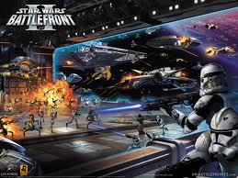

Cliché Themes
Outer space
Fire/ice
Dungeon/cavern/tomb
Factory
Jungle
Spooky/haunted house or graveyard
Pirate ship/town/island
Urban
Sewer
Battle front

Slide 21
Theme Parks
Progression
Disney land: world to land to attraction to scene
Video game: world to level to experience to moment-to-moment gameplay.
Telling a story!
From Level Up! by Scott Rogers

Slide 22

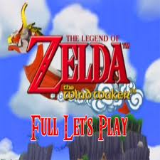
Stories in Disneyland
Escape/survive
Example: Half-life
Action and location
Explore
Example: Island village in Legend of Zelda: Wind Waker, and City of Megaton in Fallout 3
Freedom of movement, conversation, content

Slide 23


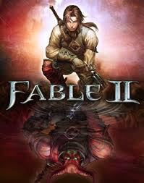

Stories in Disneyland
Educate
Example: Assassin's Creed and guitar Hero
Observation and imitation
Moral
Example: Fable 2, Star Wars: Force Unleashed, Bioshock
Choice and consequences

Slide 24
Key Design Principles (1/3)
Universal level design principles
Make the early levels of a game tutorial levels
Vary the pacing of the level (more later)
When the player surmounts a challenge that consumes his resources, provide more resources
Many games fail to do that
Avoid conceptual non sequiturs
Unrelated, illogical, irrelevant, contradictory
Example: Room accessible only via ventilation shafts

Slide 25
Key Design Principles (2/3)
Universal level design principles (cont.)
Clearly inform players of short-term goals
Unless you offer a sandbox where players simply play around
You do not need to tell what needs to do to win but you should never leave him wondering what to do next.
Be clear about risks, rewards, and consequences
Benefits of success and the price of failure
Doorknob – open the door and may release a giant killer robo-camel.

Slide 26
Key Design Principles (3/3)
Universal level design principles (cont.)
Reward the player for skill, imagination, intelligence, and dedication
Power-ups, shortcut through the level, mini-games, cut-scenes, other narrative material or simple praise.
Reward in a large way, punish in a small way
The purpose of an artificial opponent is to put up a good fight and then lose
We always want the player to win eventually
Unbeatable level is a badly designed level
Implement multiple difficulty settings

Slide 27
Genre-Specific Level Design Principles
Action game—vary the pace
More stress on player
Player must be able to rest – both mentally and physically
Strategy game—reward planning
Give defensible position to build in and advantageous position to attack from
But let the player discover these places
Role-playing game—offer opportunities for character growth and player self-expression
Character growth is a major goal in RPG, even important than win to some players
Provide opportunities for character growth by a means of reward – combat, puzzle-solving, trade.
Notes:
Verisimilitude means having the appearance of truth. Sports games must be realistic.

Slide 28
Genre-Specific Level Design Principles
Sports game—verisimilitude is vital
Consists of individual matches played in different stadium
Different teams or athletes
Simulation must be convincing (close to real)
Not only appearance but also performance characteristics of the athletes and coaching strategies
Vehicle simulation—reward skillful maneuvering
Primary activity is steering
Test skill at maneuvering his vehicle
Construction and management simulation—offer an interesting variety of initial conditions and goals
Scenarios rather than level
SimCity 3000 Unlimited – 13 Scenarios

Slide 29
Genre-Specific Level Design Principles
Adventure game—construct challenges that harmonize with their locations and the story
Exploration and puzzle solving
Harmonize challenges with current level and story
Example: A room full of machinery should have challenges involving machines
Artificial life game—create many interaction opportunities for the creatures in their environment
Puzzle game—give the player time to think
It is problem solving – knows no time table
Time pressure could be a variant

Slide 30
Layouts
The layout of the space significantly affects players perception of the experience
For games with travel, especially avatar-based games
Type of layouts
Open
Outdoors; unlimited move; e.g. war games
Linear
Parallel
Ring
Network
Hub
Combination

Slide 31
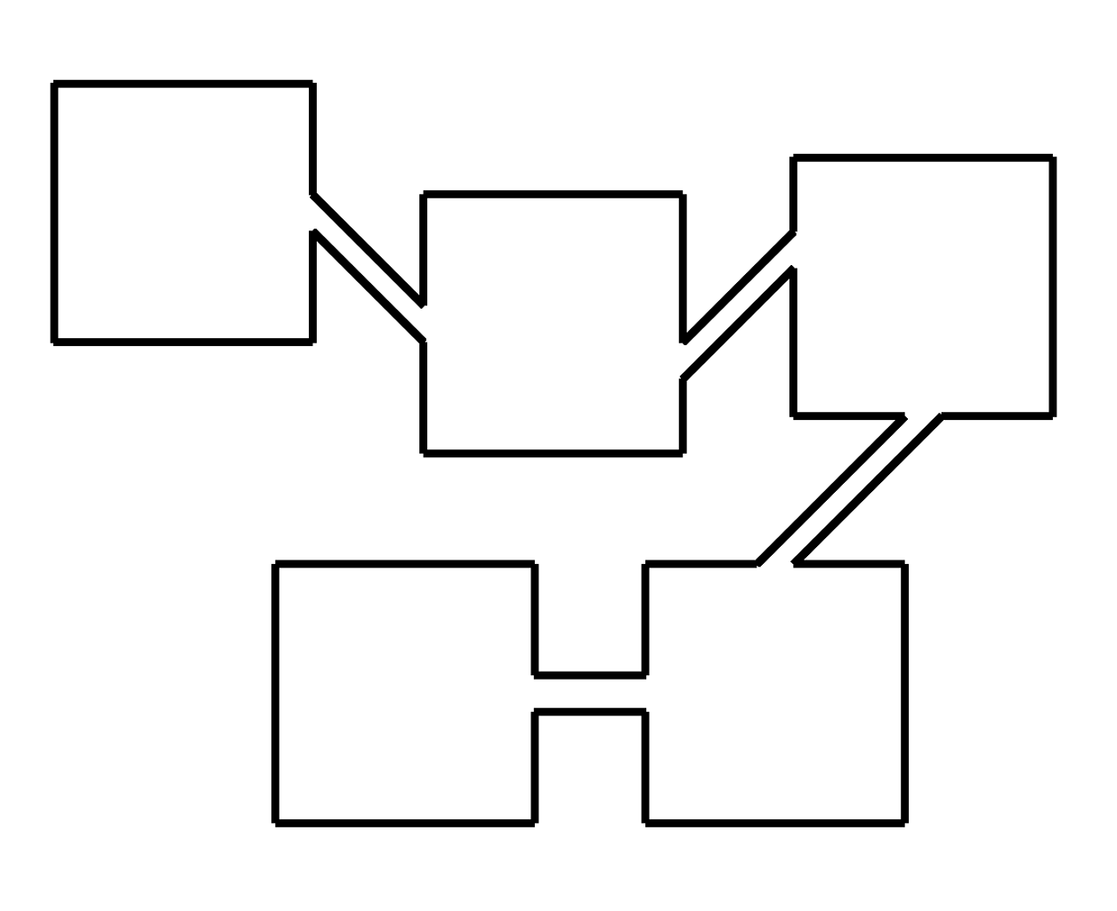
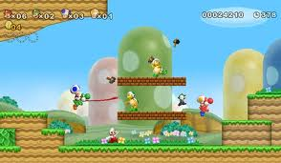
Linear Layout
Require player to move in a fixed sequence
Player can move only to next or previous area
Used traditionally in side-scrolling action games and rail-shooters

Slide 32
Linear Layout
Start
End
Start at one end, finish at the other end
Challenge in making a truly interesting experience
Ex: Half-life - great story
Often try with graphics, abilities, etc.
Used to a big extent by many games

Slide 33
Branching
Start
Branch
Branch
Branch
End A
End B
End C
Choices lead to different endings
User has a lot of control
Design has burden of making many interesting paths
Lots of resources

Slide 34
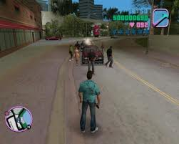
Open
Player does certain number of tasks
Outcome depends upon the tasks.
Systemic level design
Designer creates system, player interacts as sees fit
Sometimes called “sandbox” level. (Ex: GTA)
Start
Objective
Objective
Objective
Objective
End

Slide 35
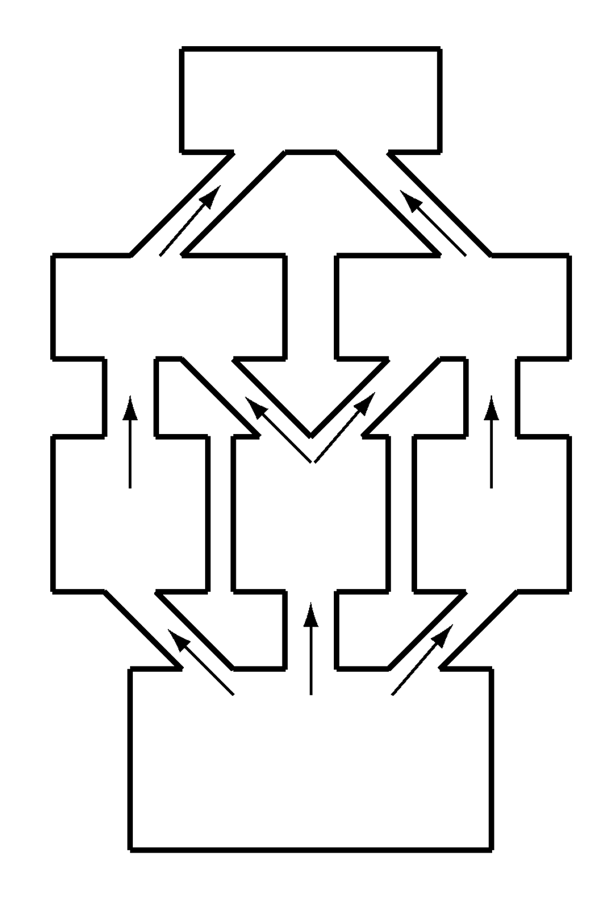
Parallel Layout
Modern variant of linear layouts
Variety of paths can go through the level
Can reflect a foldback story structure

Slide 36
Parallel Layout
Start
Bottle-
Neck A
Bottle-
Neck B
End
Various points, path splits, allowing choice
Gives feeling of control
Example: Choice of stairs or elevator
At some point, paths converge
Designer can manage content explosion
Examples: must kill bad guys on roof

Slide 37
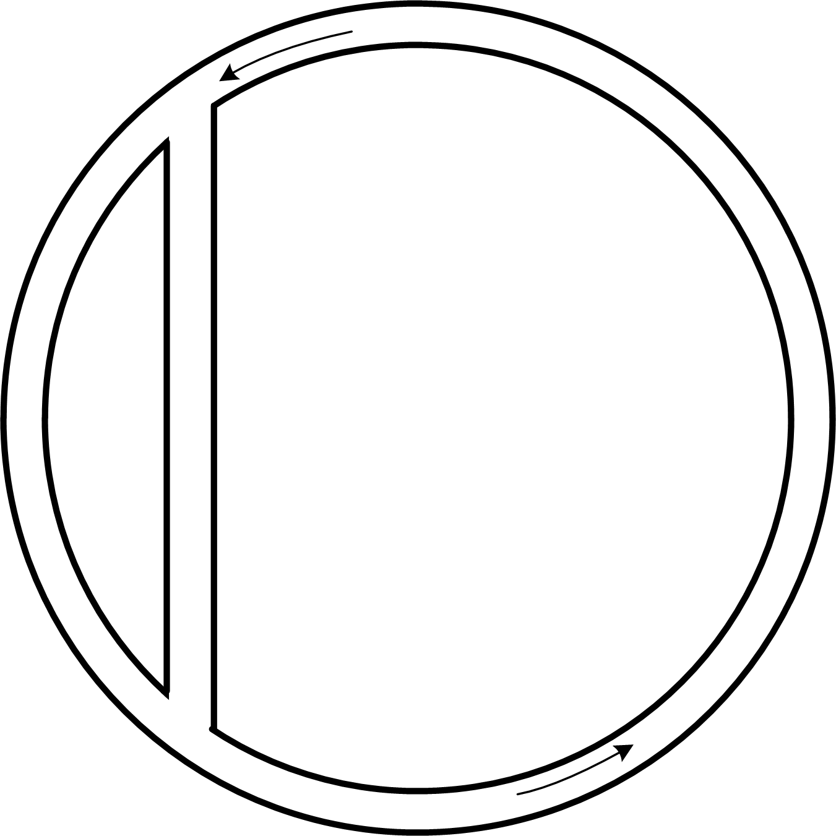
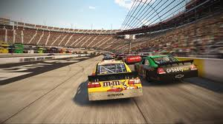
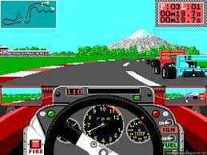
Ring Layout
Used for racing games.
Path returns to its starting point.
Oval tracks or twisting road-racing tracks are rings.

Slide 38
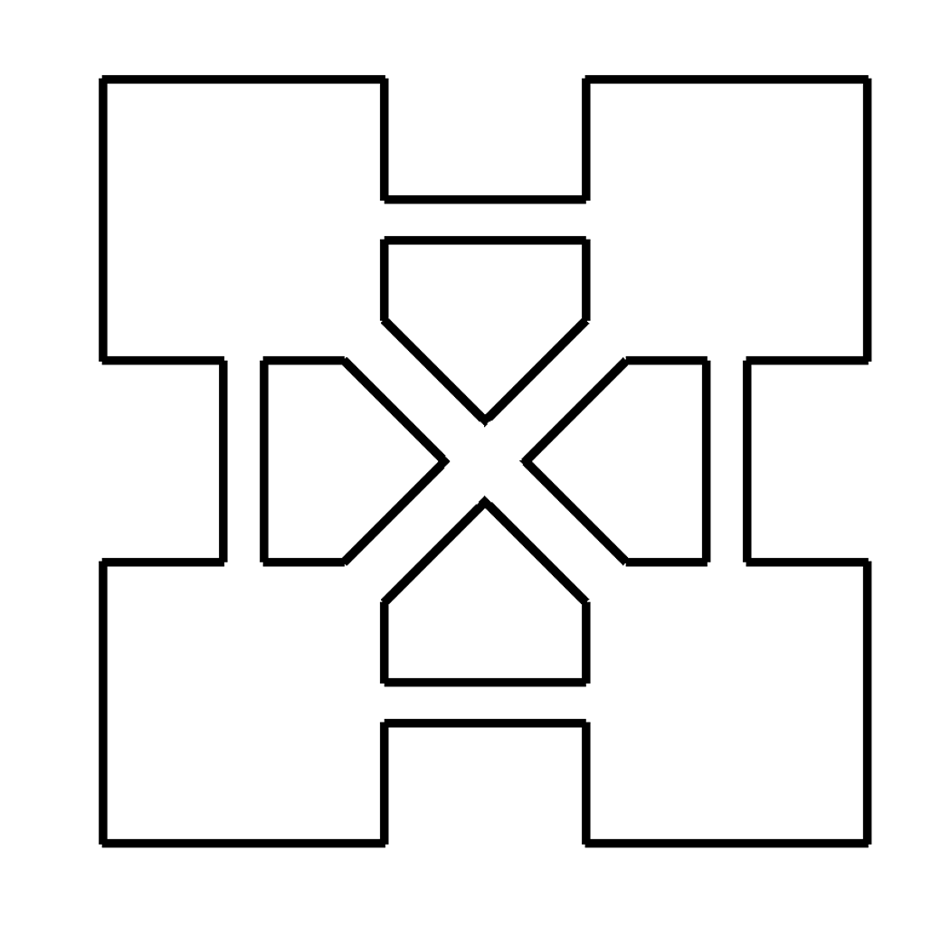
Network Layout
Spaces connect to other spaces in different ways
Give the player freedom to take any path
Stories must be able to tolerate player experiencing events in any sequence

Slide 39
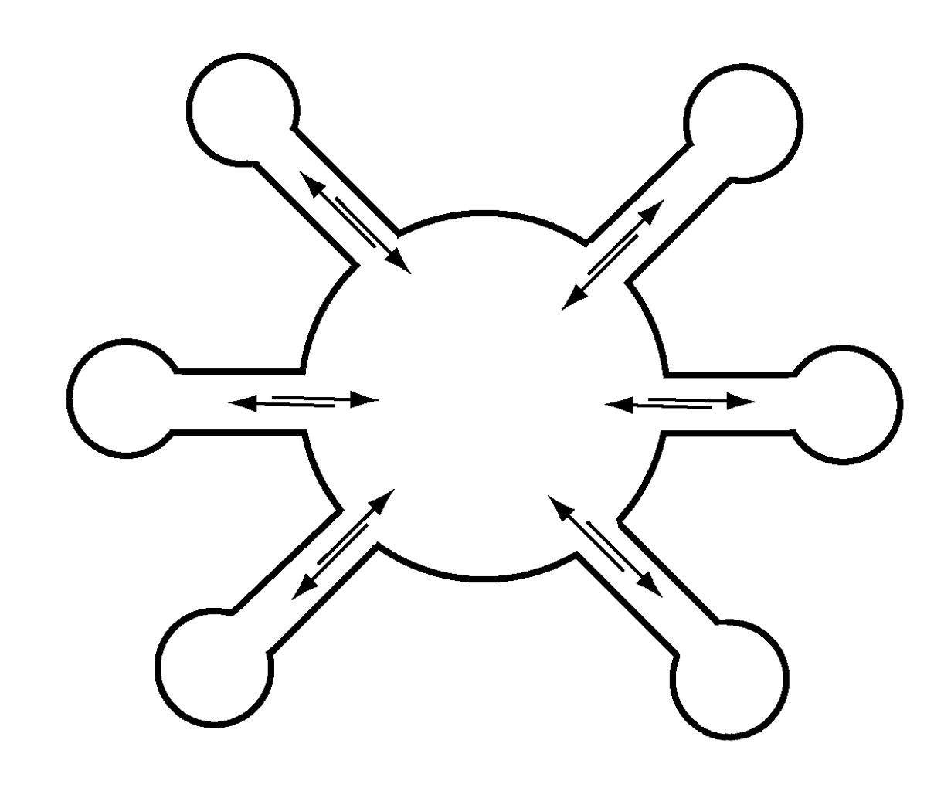
Hub Layout
Central hub is usually a safe zone
Provides some choice of where to go
Lock off some areas to control player experiences

Slide 40
Level Flow Model: Hub and Spokes
Hub is level (or part of a level), other levels branch off
Means of grouping levels
Gives player feeling of control, but can help control level explosion
Can let player unlock a few spokes at a time
Player can see that they will progress that way, but cannot now
Level A
Level B
Start
Level C
Level D

Slide 41
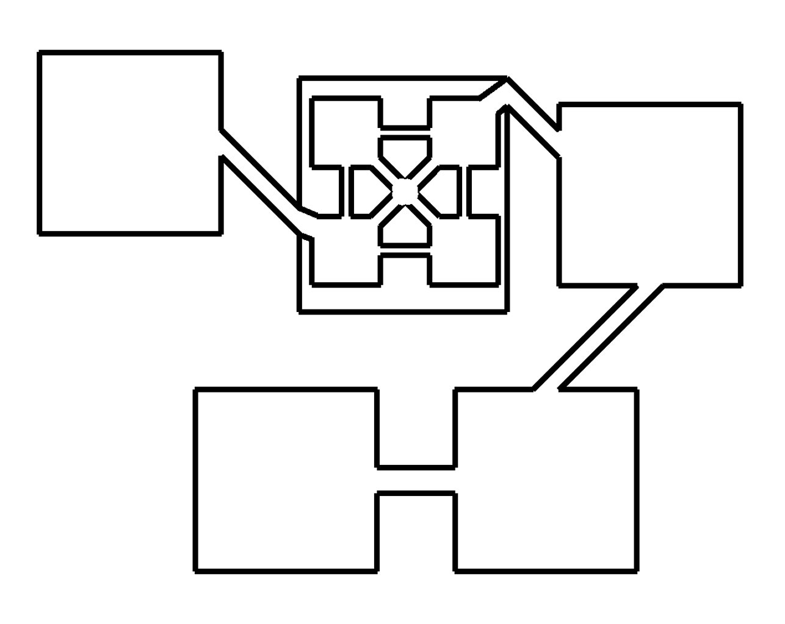
Combination Layouts
Combines aspects of several layout types
Role-playing games and adventure games often use combination layouts

Slide 42
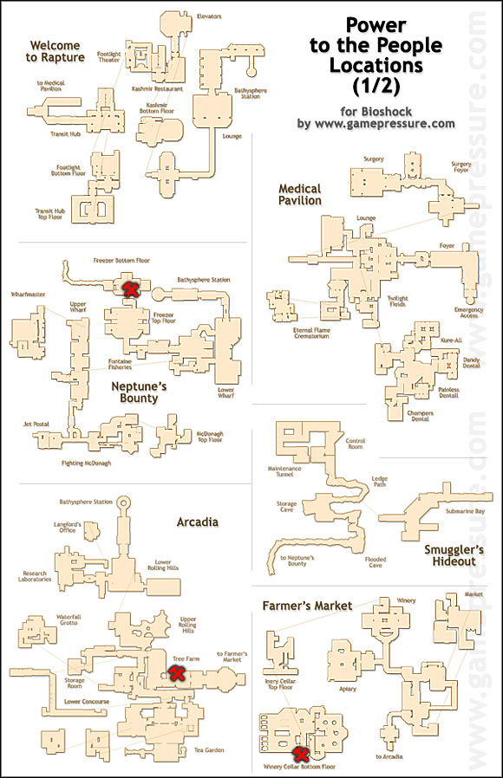
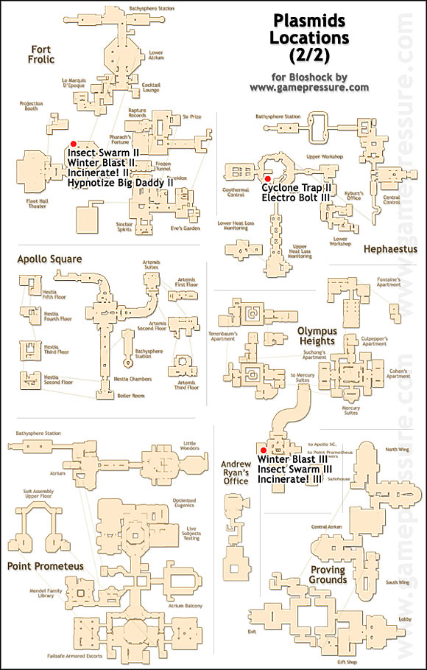
Bioshock

Slide 43
Space
Perspective & camera
Terrain & materials
Radiosity & effects
Scale
Boundaries
Reality
Aesthetics

Slide 44
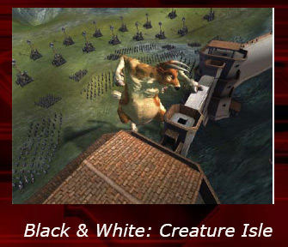
Omnipresent

Slide 45
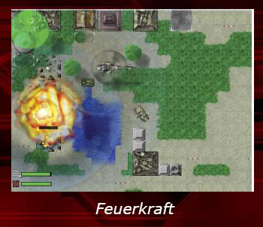
Aerial (Top-Down)

Slide 46
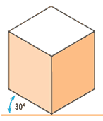
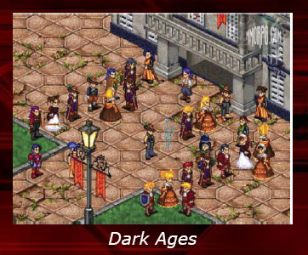
Isometric
Isometric projection is a method for visually representing 3D objects in 2D in technical and engineering drawings.
They show three sides, all in dimensional proportion, but none are shown as a true shape with 90 degree corners.
All the vertical lines are drawn vertically but all horizontal lines are drawn at 30 degrees to the base line. Isometric is an easy method of drawing 3D images.

Slide 47
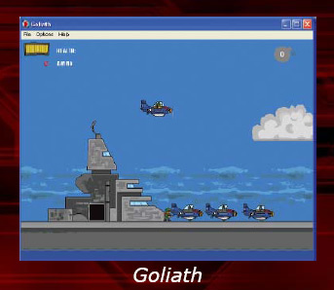
Side-Scrolling (Flat/Side View)

Slide 48
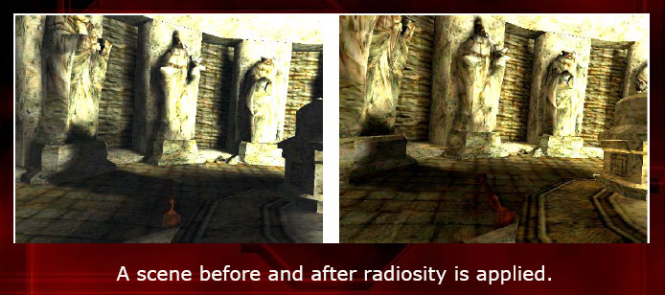
Radiosity & Effects
Radiosity is a method of rendering based on an detailed analysis of light reflections off diffuse surfaces. The images that result from a radiosity renderer are characterized by soft gradual shadows.

Slide 49
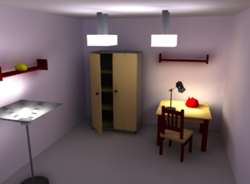
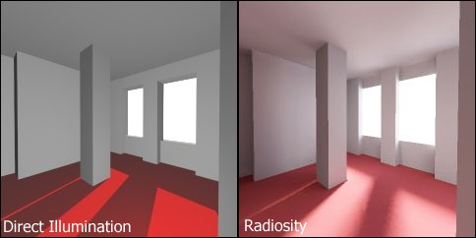
Radiosity & Effects
Radiosity is a method of rendering based on an detailed analysis of light reflections off diffuse surfaces. The images that result from a radiosity renderer are characterized by soft gradual shadows.

Slide 50
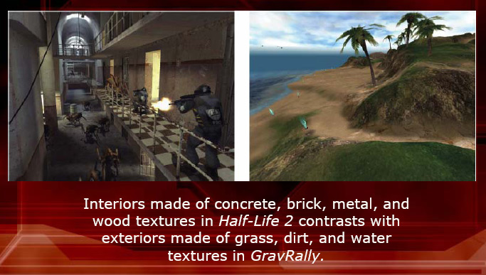
Terrain & Materials

Slide 51
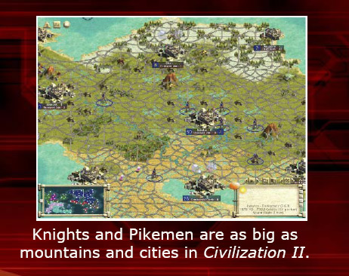
Scale

Slide 52
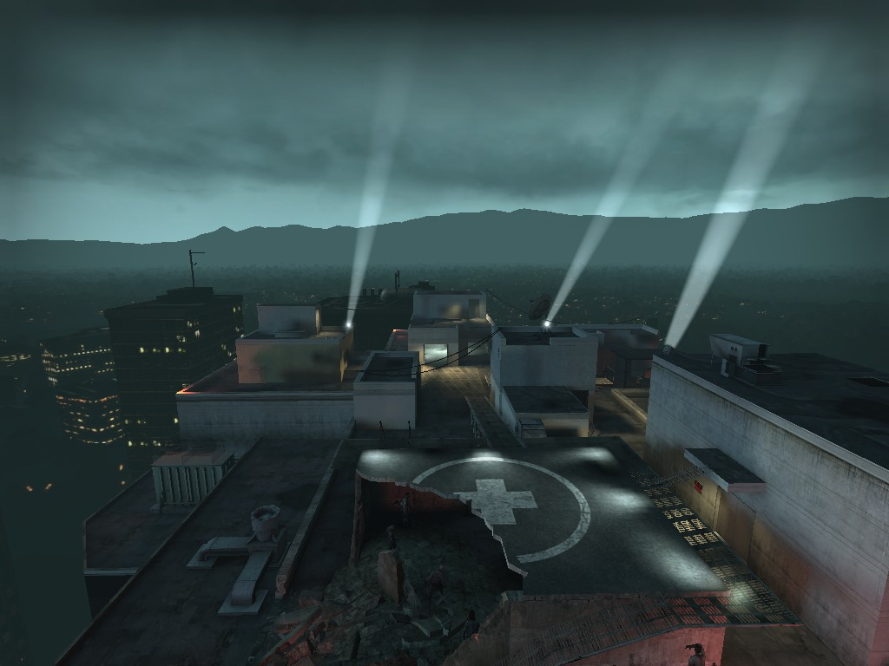
Boundaries
Rooftop is boundary but mountains give illusion of more boundaries

Slide 53
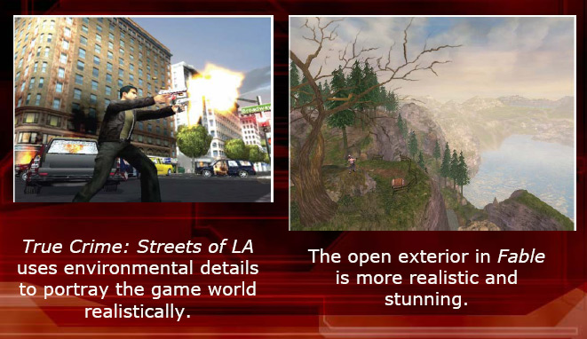
Reality

Slide 54
Expanding on the Principles (1/6)
Level designer assembles components to create the atmosphere
Lighting
Color palette
Weather and atmospheric effects
Special visual effects
Music
Ambient audio
Special audio effects

Slide 55
Expanding on the Principles (2/6)
Lighting
Placement and orientation of light can create
A sunny day, a moonlit night or a dark alley.
Soft morning light filtering through a window
Creates a sense of warmth and well-being
Odd glowing colored lights
A sense of danger
What to choose not to light is just as important as what you choose to light

Slide 56
Expanding on the Principles (3/6)
Color Palette
The color palette of
Avatar’s clothes reflects her character
The level reflects its mood
Weather and atmospheric effects
Distinct impression
Fog – create mystery
Dark tumbling skies presage a storm
Strong wind – suggest instability and disturbance to come
Youtube

Slide 57
Expanding on the Principles (4/6)
Visual Effect
Weapon recoil or screeching tires – Smoke
Magic Spell – colored sparks
Blood splashes across a wall
Youtube Another
Music
Helps to set the pace, and its timbre
Usually music remains consistent
Ambient and special audio
Contributes to the mood of the level
The sound of birds singing in Golf

Slide 58
Expanding on the Principles (5/6)
Pacing refers to the frequency of individual challenges
Genre affects pacing
Multiplayer deathmatch shooters use the fastest pace
Adventure games use the slowest pace
Vary the pacing with fast and slow periods
A game with physical challenge
Alternate between fast and slow periods
A stressful challenge should followed by a brief period
Overall pacing should remain steady or become more difficult near the end of the level

Slide 59
Expanding on the Principles (6/6)
Tutorial levels teach the player how to play
Scripted or partially scripted experience that explains the game’s user interface, key challenges, and actions
Voiceover narration, text, or a special character can explain the game

Slide 60
The Level Design Process (1/7)
Design to level design handoff
Game designer (GD) will tell
Settings, mode, key gameplay activity and events
List features in the level
Events that can be triggered by the player
Props that will be present in the level
NPCs
Create a rough overview map of the level

Slide 61
The Level Design Process (2/7)
Planning phase
Plan the level in detail
Plan the sequence of events (use paper and pencil)
Document
Gameplay
Art
Performance, and
Code requirements

Slide 62
The Level Design Process (3/7)
Prototyping
Construct temporary models of the landscape and objects (usually 3D)
Models serve as blueprints for the art team
Features:
Physical shape of the game world
Temporary texture to give it a surface
Temporary models of props - Trees, furniture, buildings
Path planned for Ai-Driven NPCs
A lighting design
Locations of trigger points for key events
Placing triggers and documenting that sets them off is referred to as rigging

Slide 63
The Level Design Process (4/7)
Level review
Review the prototype
Feedback from the design, art, programming, audio, and testing teams
Issues to address
Scale –
right size? Will it take too much or too little time to play through?
Pacing –
Does the flow of events feel right?
Placement objects and triggers
Performance issues
complicated level for the processor to handle
Aesthetics
Attractive and enjoyable to inhabit?

Slide 64
The Level Design Process (5/7)
Level refinement and lock-down
Make corrections based on feedback
Review and correct until the level is flawless
Lock the level
Level design to art handoff
Give all files to the artists
Specify how the level should look & work
Contact the audio team for needed audio

Slide 65
The Level Design Process (6/7)
First art and rigging pass
Art team builds the real artwork and rigging
You might need to incorporate the new content into software
Art to level design handoff and review
Receive final artwork
Conduct a review

Slide 66
The Level Design Process (7/7)
Content integration
Assemble all assets into completed level
Adjust any rigging as necessary
Bug fixing
Test for bugs and hand off to QA
User testing and tuning
QA: test plan and alpha testing
When thoroughly alpha tested, hand off to beta testing

Slide 67
Design Decisions
Concept
Style
Challenges
Actions (skills)
Level types
Level narrative
Progression

Slide 68
Level Design Ingredients
Two ingredients are
Game Obstacles
Elements of the game that challenge a player
Game Skills
Obstacles force the player to react using game skills

Slide 69
Challenging the Player
A level is an elaborate obstacle course presented to the player
Types of obstacles
Roadblocks (basic)
Enemies (to kill)
Traps (to avoid)
Puzzles and mini-games (to solve)

Slide 70
Challenging the Player
Roadblocks - the basic obstacle
Slow down the player character
Example: fence or railing – the player character must jump over
Enemies – the obstacle you shoot
Harm the player character!
Example: vehicles, or creatures
Enemies can be grouped
Boss!

Slide 71
Challenging the Player
Traps - to avoid
Cause damage to the player
Part of the environment
A warning or cue that tells the character might be in danger
Puzzles and mini-games - to solve
Require brainpower to solve
Provide a needed break

Slide 72
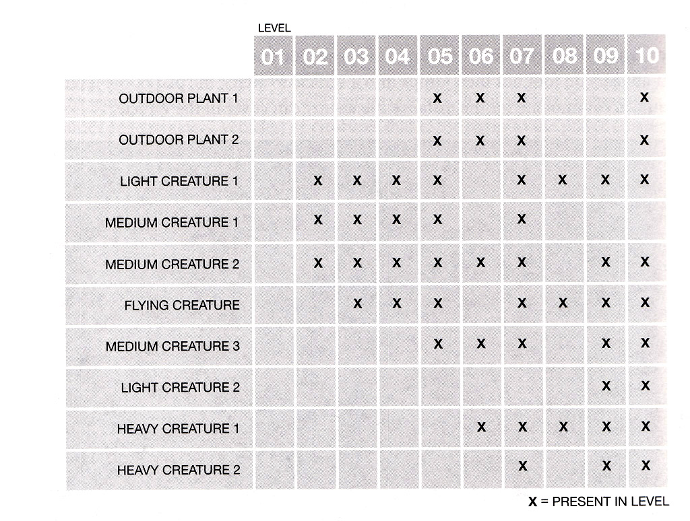
Enemy Chart
Rank enemies according to difficulty
The level progression should show easier-to-defeat enemies early.

Slide 73
Notes
When designing a level with a new enemy, create a unique area to introduce the enemy in a dramatic way.
Players remember these moments!
Traps should have some kind of warning.
Signs, scripted events, etc.
Puzzles don’t fit in every kind of game.

Slide 74
Skills - A Design Decision
Fundamental skills are the foundation for player interaction
Players interact with obstacles through skills.
Early levels teach how to use tools.
Tutorial levels
First level contains the bulk of the instructions
Select skills to start with

Slide 75
Add new Skills
As players progress
They gain new skills
Example: weapon, item, spell
Some skills are complex
Require new buttons or keys to use
Use known interface
Solution:
Block player with a non-critical obstacle to test if they have the skill

Slide 76
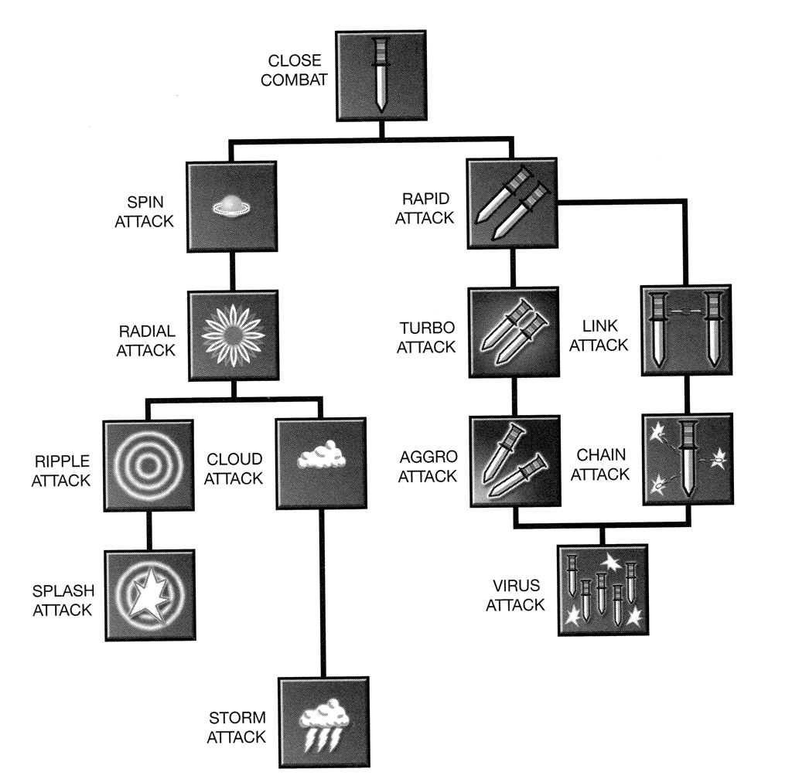
Skill Tree
The Skills are displayed in skill tree to make choices which path to take.
Choose between attacking enemies rapidly or a greater area affected

Slide 77
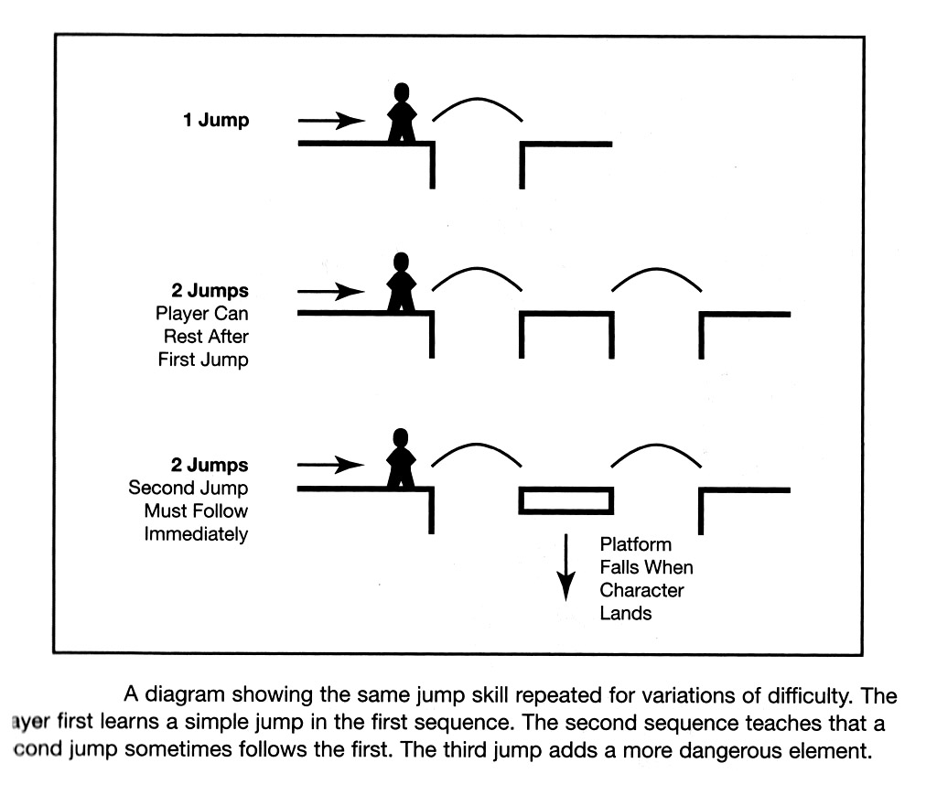
Combining Skills

Slide 78
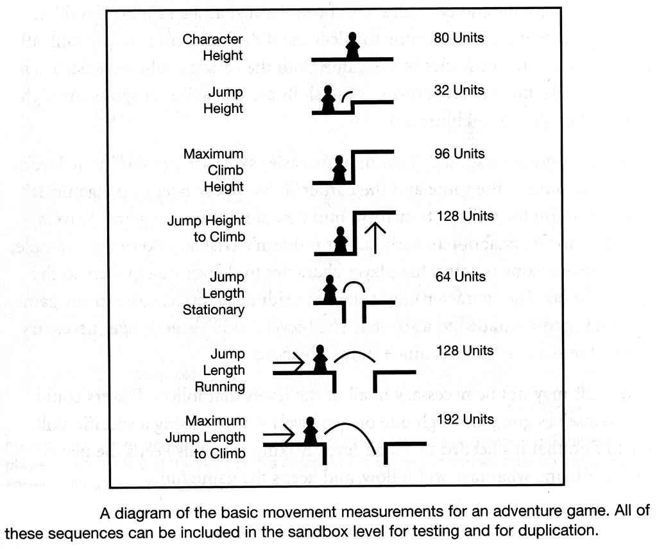
Measurement for Skills

Slide 79
Level Progression
Determine difficulty level
Once skills and obstacles are defined
A sandbox is created
Rank all skills and obstacles in the game from the easiest to the hardest.
Place skills into a chart showing what skills are needed to progress through each level

Slide 80
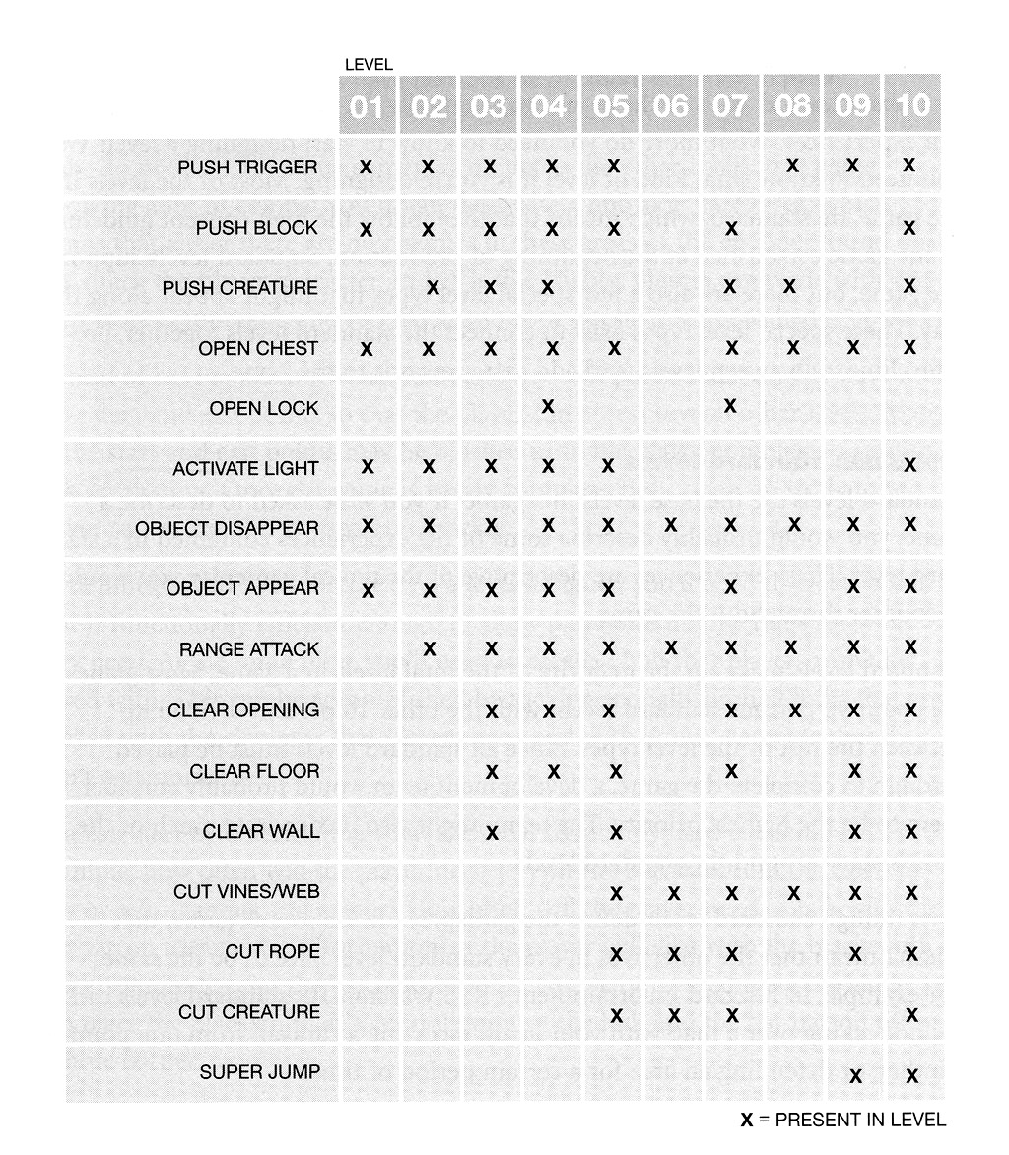
Level Progression

Slide 81
Level Types
Alley
Portal, Call of Duty?
More control (camera, events, etc.)
Island
GTA, Halo (multiplayer)
Feeling of space and exploration
Sandbox
BIG islands

Slide 82
Level Types
Base: standard levels
90% are standard levels
Transition: hubs
Not all games have hubs!
Climax: boss level
Smaller and different
Gravy: bonus level
Non-critical
Easter eggs!

Slide 83
Level Narrative
Narrative describes the challenges and explains the purpose of different areas.

Slide 84
Pitfalls of Level Design (1/4)
Get the scope right
Design within your available resources
Within time, stuff and budget
Refers to not only size and complexity of landscape but also number of props
It’s common error to design something that’s too big
Final Fantasy – need huge production team
Notes:
A non sequitur is something that does not follow logically.

Slide 85
Pitfalls of Level Design (2/4)
Avoid conceptual non sequiturs
Non sequiturs – features that make no sense
Example: Youtube
Hiding medical kits inside oil drums belongs to a class of design error
Copying from 20-year old cartoon game mechanic – resources hidden in odd places
Illogical events in a game make it harder to play
Players should be rewarded for using their intelligence
Notes:
A non sequitur is something that does not follow logically.

Slide 86
Pitfalls of Level Design (3/4)
Make atypical levels optional
Atypical levels break the player’s suspension of disbelief
Atypical levels could prevent some players from completing the game
Don’t show the player everything at once
Introduce new features gradually
Maintain the player’s interest

Slide 87
Pitfalls of Level Design (4/4)
Never lose sight of your audience
Player-centric approach
The level designer is not the player
Understand your target audience and deliver what they want

Slide 88
Summary
You should now understand
How to describe level design
How to apply key design principles
How to create a variety of layouts
How to create atmosphere, set a pace, and build tutorial levels
How to complete the level design process
How to avoid common pitfalls of level design

Slide 89
Refeences
Level Up!: The Guide to Great Video Game Design
Scott Rogers
Wiley, 2010
Level Design for Games
Phil Co
New Raiders, 2006

Slide 90
Thank you!

